Slide 1


AVANADE | MATER

Slide 2
AGENDA
Description
Scope
Delivery Approach
High Level Schedule/Dependencies
Solution Blueprint (Current) & (Purposed)
Pipeline screenshot (Purposed)
Benefits

Slide 3
Description
Mater, identified the need to optimize DevOps Pipeline for its CRM projects - MaterAtHome and MaterAtFoundation. Mater as a part of the response expecting Avanade to provide approach, better practices, timeline, resources and pricing for each of the listed requirement (as below).
Below is the high level scope items given by Mater:-
Consolidate Azure DevOps pipeline under one Azure DevOps project
Migrate code repositories from Github to Azure Repos (as applicable)
Optimize by introducing flexibility to Azure DevOps pipeline to run faster

Slide 4
Scope Definition
Scope of Work
Migrate both Azure DevOps pipeline under ONE CRM project
Migrate code repositories from Github to Azure Repos for MaterAtHome.
Use Microsoft Power Platform tool extensions instead of PowerShell commands for both projects - (MaterAtHome and MaterAtFoundation)
Migrate Power Platform STAGING (unmanaged) to UAT (managed) for MaterAtHome
Follow Microsoft best practices to securely deploy code to Power platform using Azure service principal.
Key Outputs
POC, Low-level Design Document, Modified Azure DevOps Pipelines for both projects
Streamlining and consolidating projects under one CRM Azure DevOps project
Two Azure Repos for storing the code and artifactory for storing the artifacts.
Receive notification at teams regarding the progress of pipeline
Lesser time for completion of pipeline saving time for the team
Out of Scope
Mater ERP pipeline is not considered as a part of this optimization project, because of dependency on the complex way of building the project, which is possible only through PowerShell scripts. Also, only regular user credentials must be used which is a security risk. We will follow current method of building/deploying ERP project.
MaterFoundation is already using Azure Repos and UAT uses managed solution, so only migration of code to one CRM project is required.

Slide 5
Delivery Approach Overview
Iterative delivery approach. Project is divided into three phases, At the end of each phase, workshop with client to showcase progress of the project.
Project development Team will help in validating the outcome of the pipelines.
Sourcing Strategy
DevOps Consultant (100% capacity for 5 weeks) will implement the pipelines for both the project.
Phase Name | Duration | Deliverables | Method
Analysis, POC and Design | 10 days | Analysis and POC creation in POC environment Develop low-level design and implementation process | Walkthrough of POC, low-level design and implementation process
Build and Test | 8 days | Build pipelines Perform testing on pipeline in POC environments | Walkthrough of pipeline solution for deployment; Sign-Off for production deployment
Deploy/Hypercare | 7 days | Deployment of pipeline to production environment Hypercare/Handover activities | Walkthrough of pipeline deployed in Production Environment / Client Sign-Off

Slide 6
Indicative High Level Schedule
 | Avanade activity
 | Client activity
Artifacts
Note: This schedule provides indicative timeline ONLY. It will change based on overall solution and delivery approach and is to be validated as part of overall solution and during mobilization.
Workshop/Checkpoint for Validation & Revision
OVERALL SCHEDULE | Analysi
Simplifying DevOps | W1 | W2 | W2 | W4 | W2 | W6 | W4 | W8 | W3 | W10 | W11 | W12 | W4 | W14 | W15 | W16 | W5 | W18 | W19 | W20
Analysis, POC
Design
Build
Test
Deployment/Hypecare
Analysis and POC creation
1
A01, A02
Creation/Update of Low-Level Design and implementation process
Build Pipelines in POC Environment
2
A03
Test Pipelines in POC Environment
A04
3
A05
Deploy Pipelines
Hypercare /Handover
Artifact ID | Title | Target Due Date
A01 | Low-level Design & Implementation Process | 14 October 2022
A02 | POC | 14 October 2022
A03 | Test Plan – Test Scenario and Test Cases | 19 October 2022
A04 | Test Summary – Test Cases with test results | 25 October 2022
A05 | Pipelines deployed to Production Environment | 2 November 2022
ID | Title | Target Due Date
 | Walkthrough of POC, low-level design and implementation process | 14 October 2022
 | Walkthrough of pipeline solution for deployment; Sign-Off for production deployment | 26 October 2022
 | Walkthrough of pipeline deployed in Production Environment / Client Sign-Off | 2 November 2022
1
2
3

Slide 7
Indicative High Level Schedule – Dependencies
Initiate of this project should start on completion of the following things: -
# | Dependency | Impact | By When | Obligation With
1 | Read access to Github Mater account | POC work cannot be started | Before start of the project | Mater Team
2 | Creation for Mater account and provide admin access to Azure DevOps | POC work cannot be started | Before start of the project | Mater Team
3 | POC Dev and POC Test environment | POC work cannot be started | Before start of the project | Mater and MaterAtHome Developer
4 | Access to Azure AD of Mater | POC work will be delayed | Before start of the project | Mater Team
5 | Migration of MaterAtHome Staging (Unmanaged) to Uat (Managed) | Deployment phase will be delayed | Before the commencement of Build/Deployment phase | Mater and MaterAtHome Developer

Slide 8
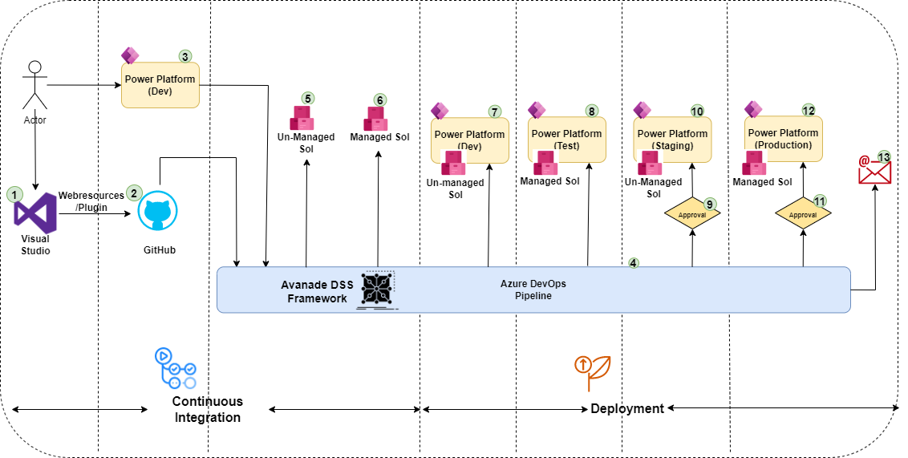
Solution Blueprint - Current (MaterAtHome)

Slide 9
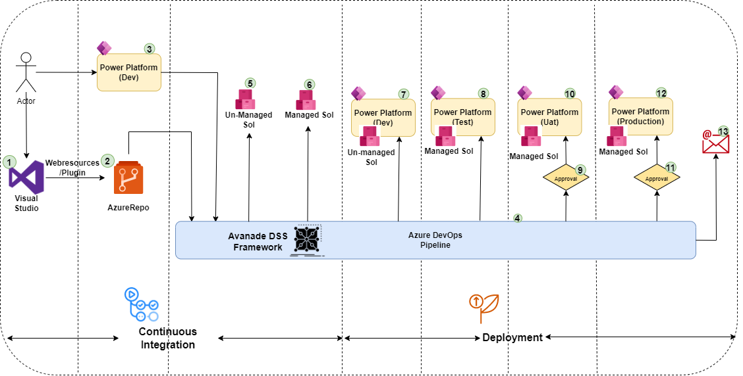
Solution Blueprint - Current (MaterFoundation)

Slide 10
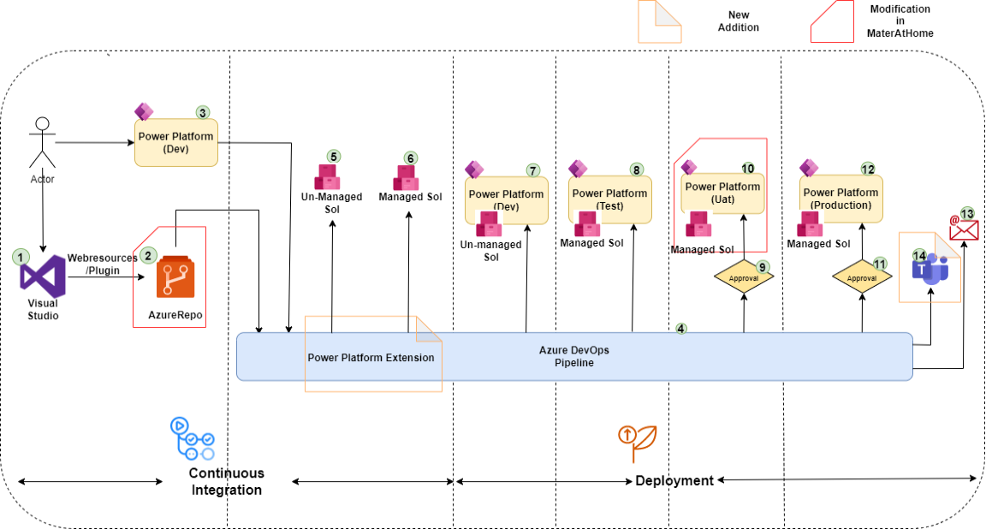
Solution Blueprint – Proposed (MaterAtHome, MaterFoundation)

Slide 11
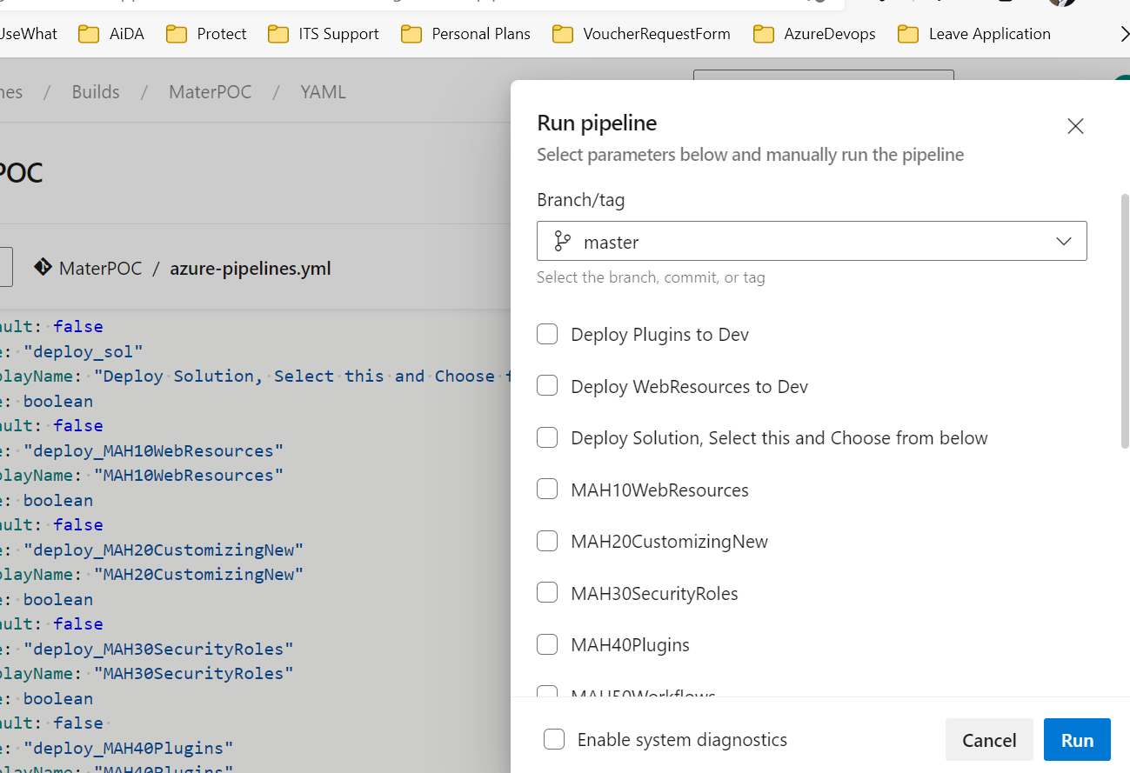
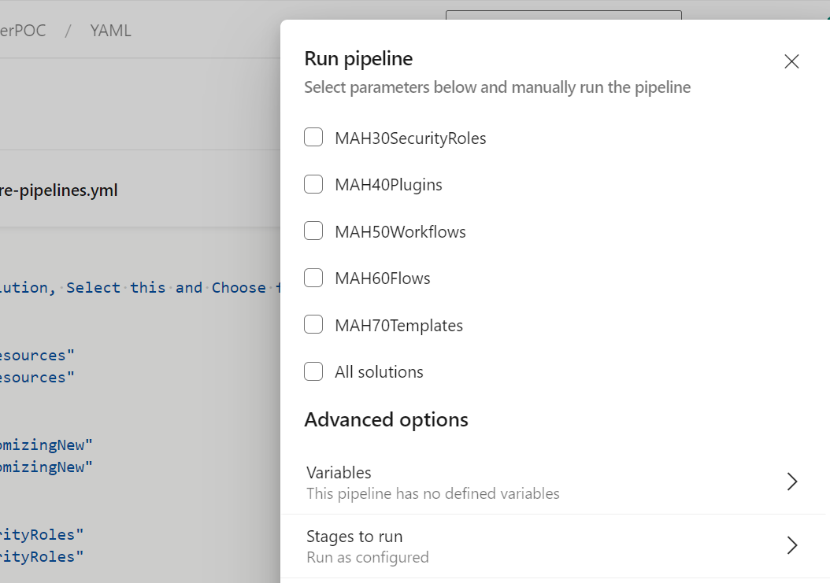
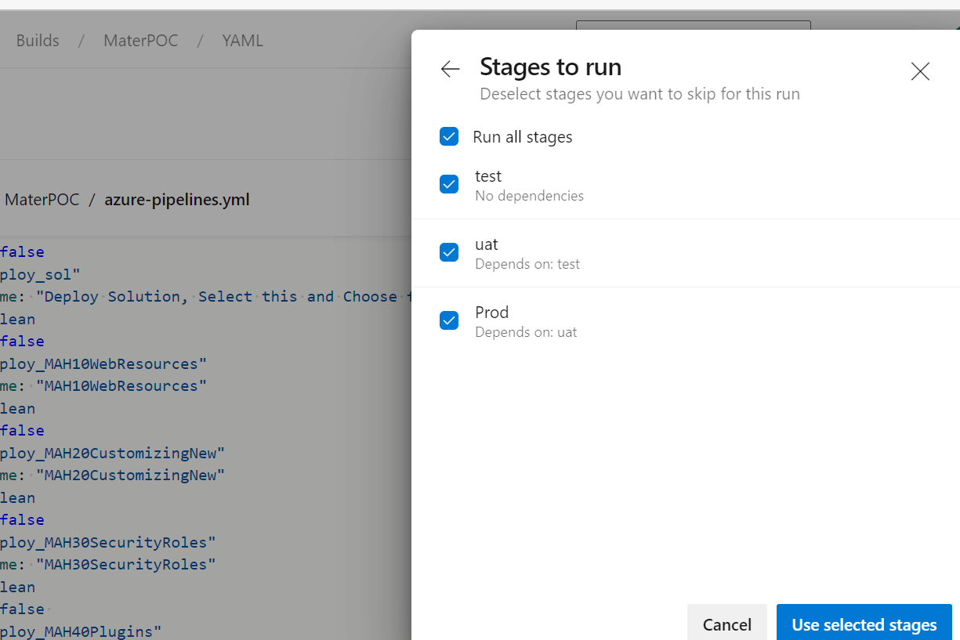
Pipeline Screenshot – MaterAtHome - Purposed

Slide 12
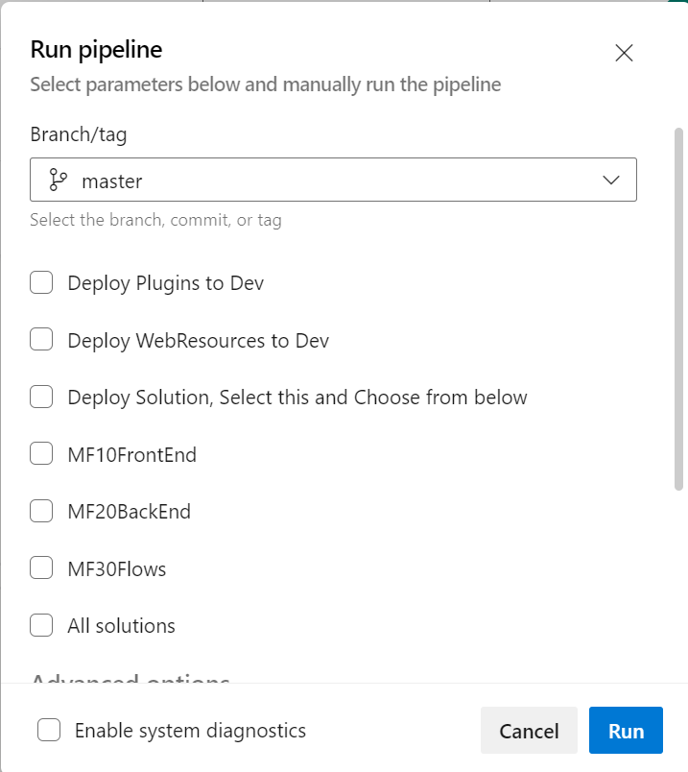
Pipeline Screenshot – MaterFoundation - Purposed

Slide 13
Benefits
New Solution offers the following benefits: -
Consolidate Azure DevOps pipeline and Azure Repos under one Azure DevOps project. This will enhance logical grouping of CRM projects and align with the future business decision.
Flexibility to deploy components/solution based on the needs of the project.
Optimize Azure DevOps pipeline to run quicker/notification through teams.
Following Microsoft Best Practices for security by using Azure Service Principal and Microsoft Marketplace extensions.

Slide 14

Q/A

Slide 15
Thank you

